Slide 1
GIT and GITHUB
Version control for software collaboration.

Slide 2
Why you need it
Some form of version control is almost always used in software development projects.
There are different types of version control.
Git is one type that is open source and gaining in popularity.
Because Jose says you need it.

Slide 3
Git vs Gitub
Git is a version control program that manages programs stored in repositories.
Each computer that it is stored on counts as a repository that can be linked together.
There are various implementations of Git:
Git bash (commandline)
Git for windows (GUI)
Github (web based)
And many others
GitHub is a convenient way of setting up a common central repository for managing a project from.

Slide 4
Some resources
https://github.com/
Git command line tutorial: http://try.github.io/levels/1/challenges/1
Download for Git Bash: https://openhatch.org/missions/windows-setup/install-git-bash
For information on using the Git functionality of Eclipse: http://wiki.eclipse.org/EGit/User_Guide

Slide 5
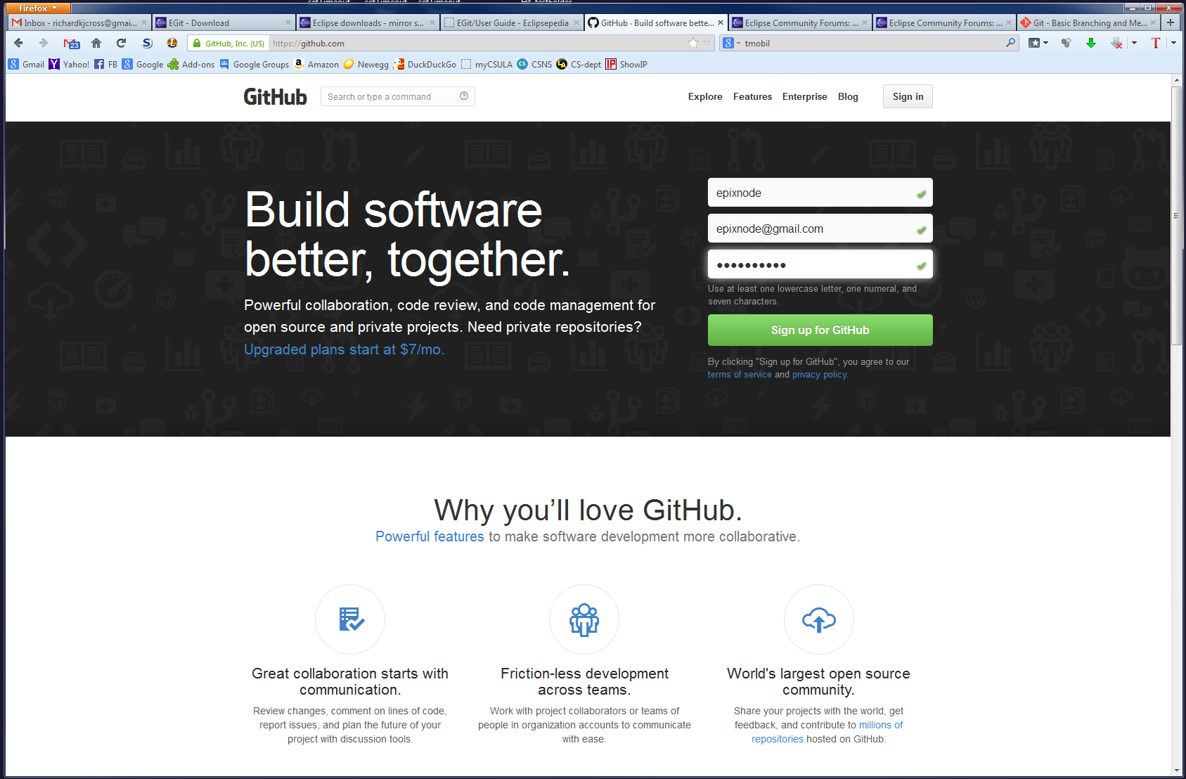
Setup GitHub account

Slide 6
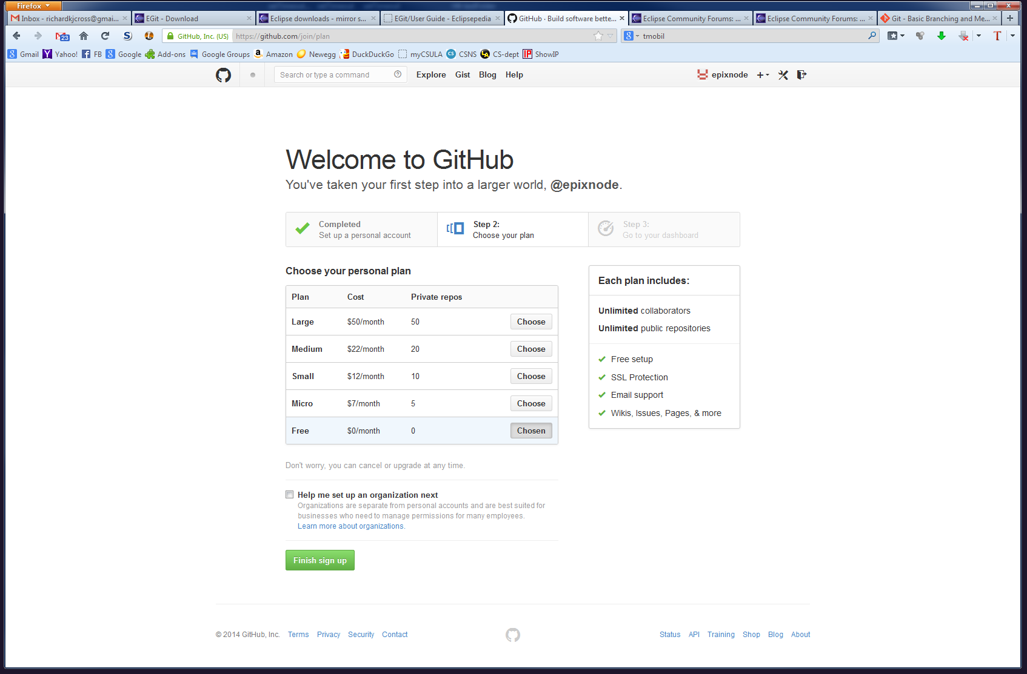
Choose the free account

Slide 7
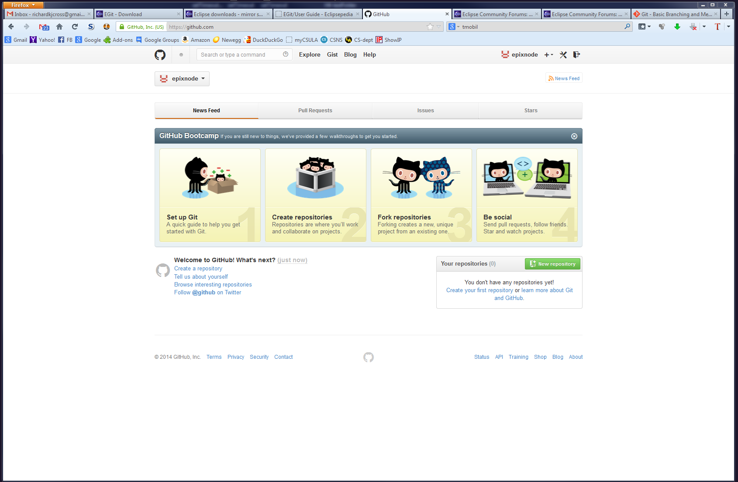
Welcome to GitHub

Slide 8
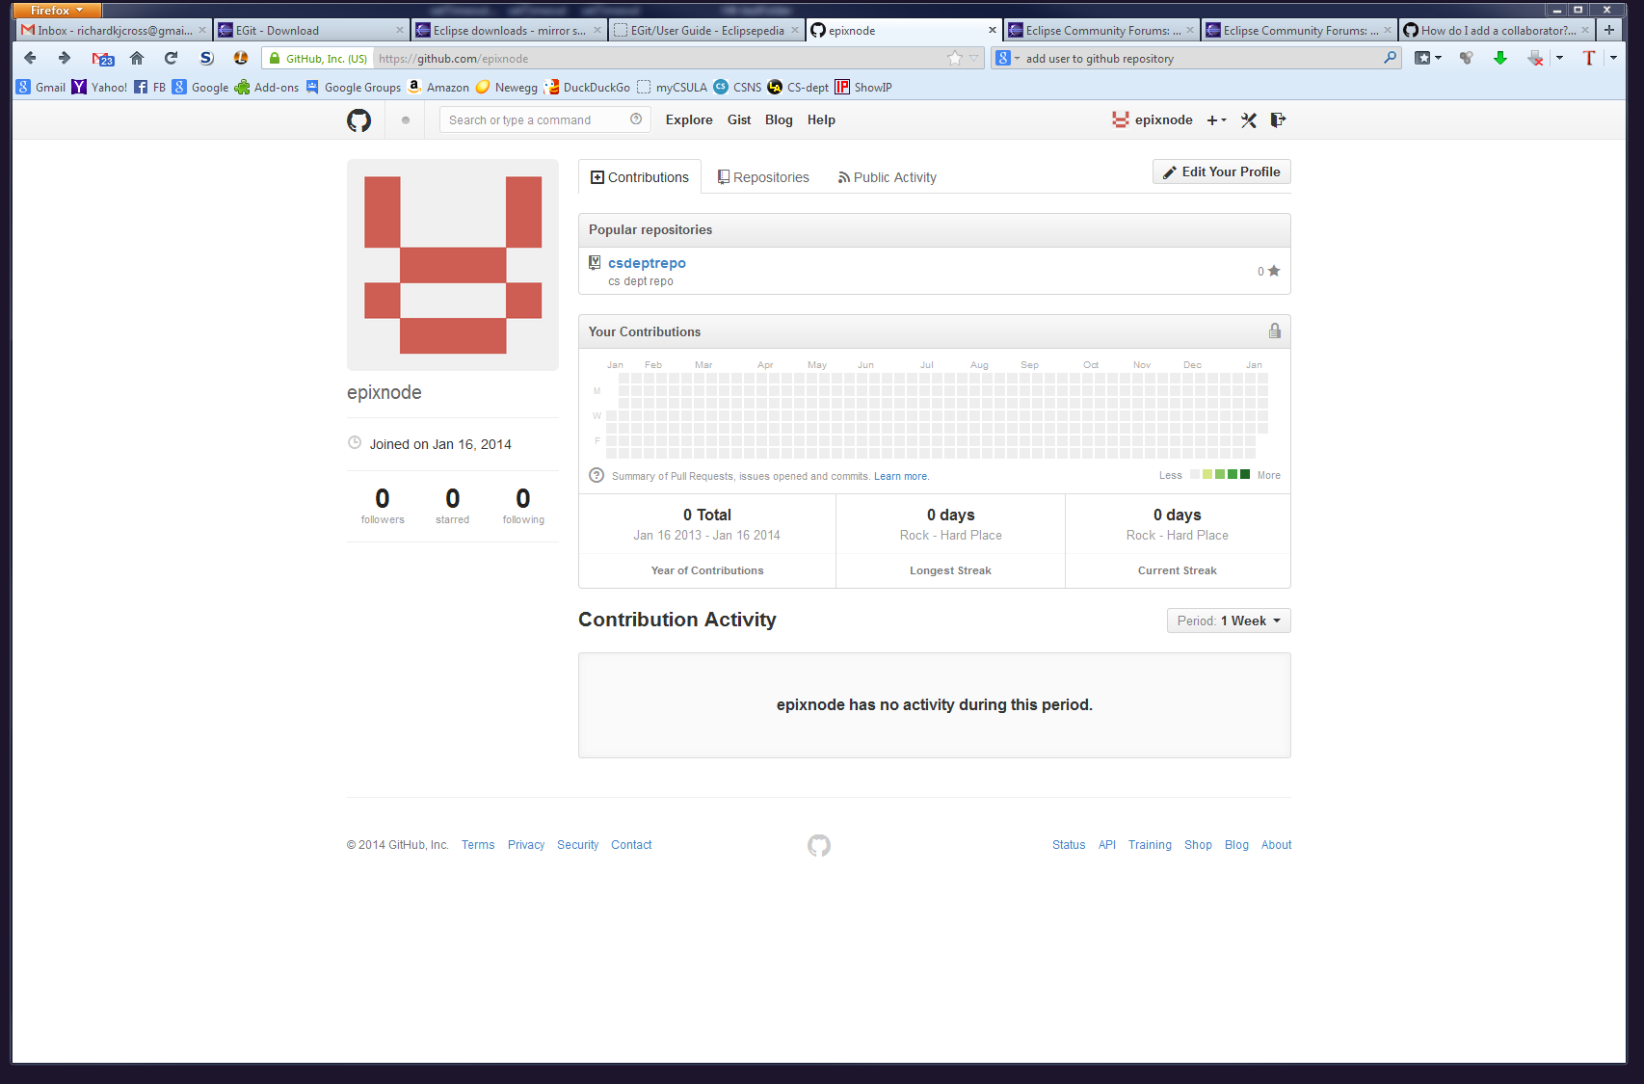
Account setup finished

Slide 9
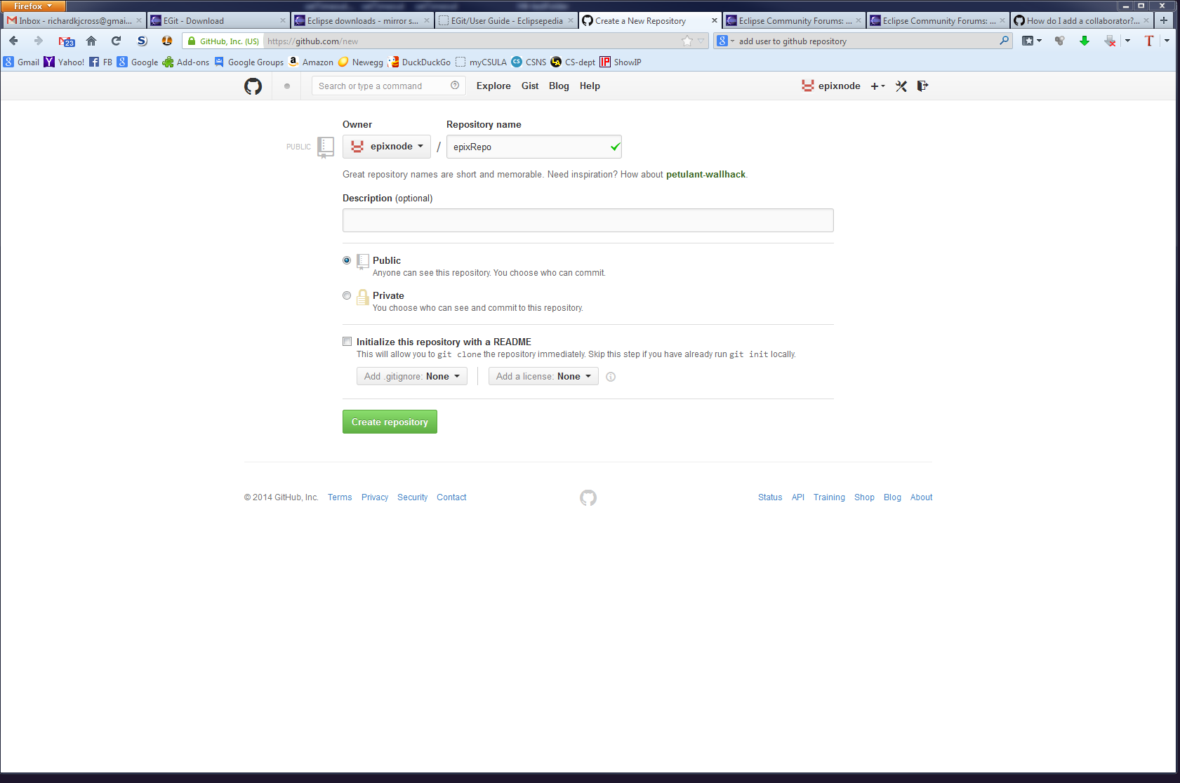
Create a repository

Slide 10
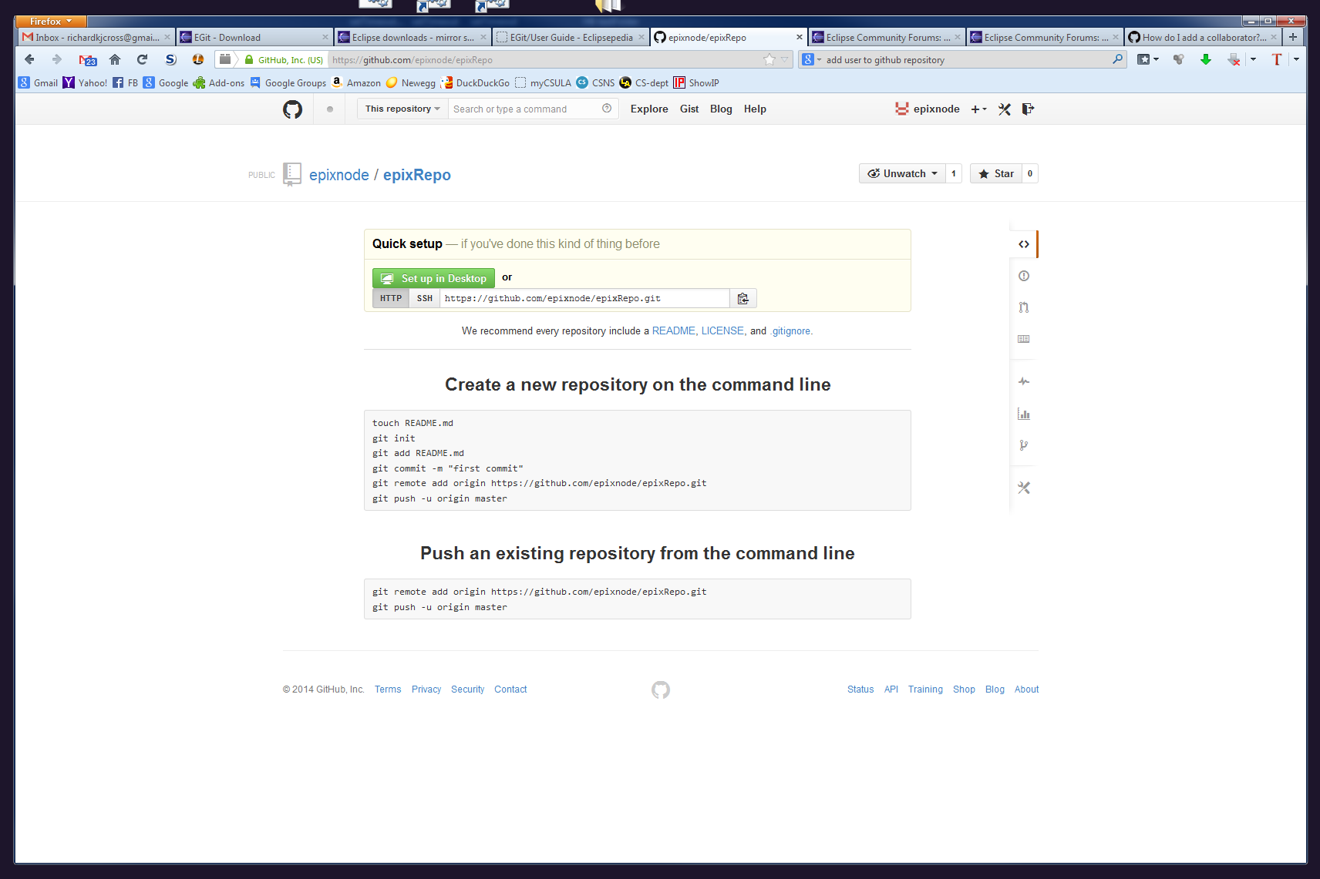

Slide 11
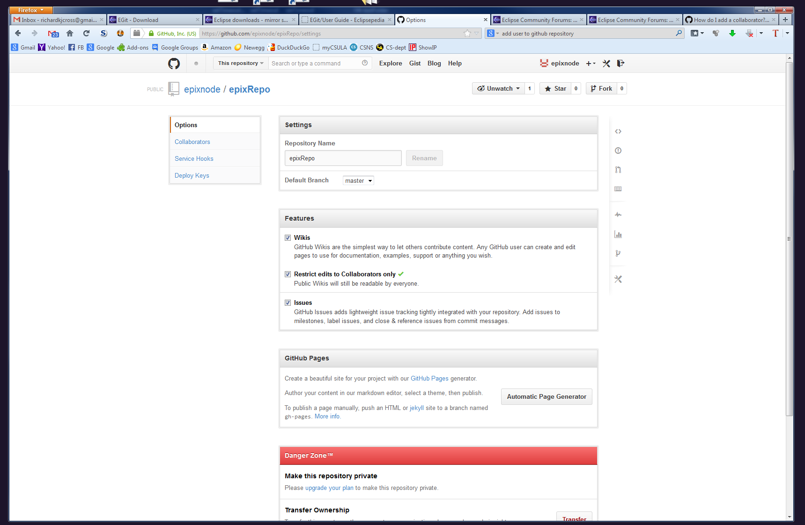
Choose the setting that only lets collaborators submit code

Slide 12
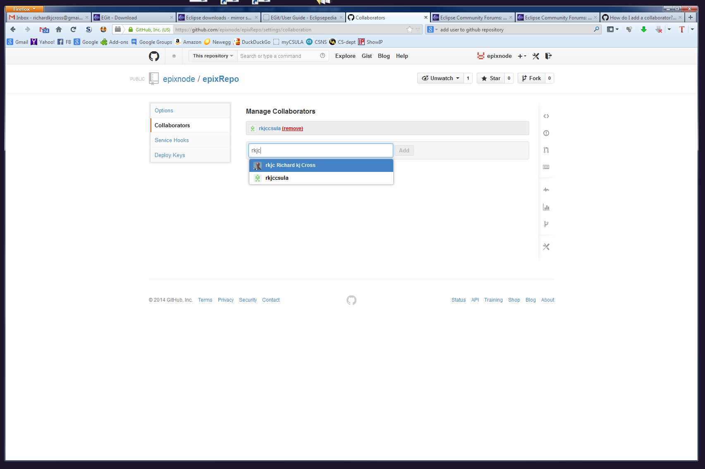
Add collaborators

Slide 13
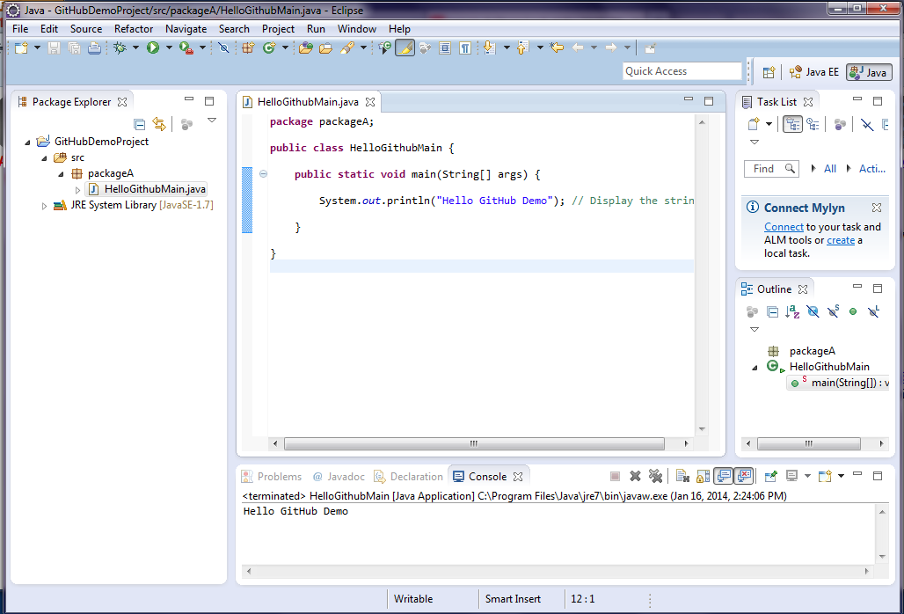
Create a project in Eclipse

Slide 14
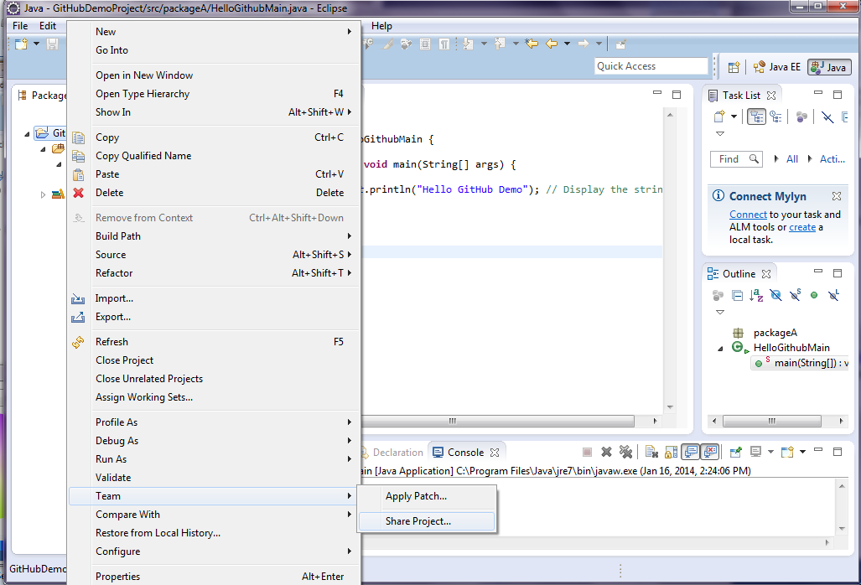
Push Eclipse project to GitHub

Slide 15
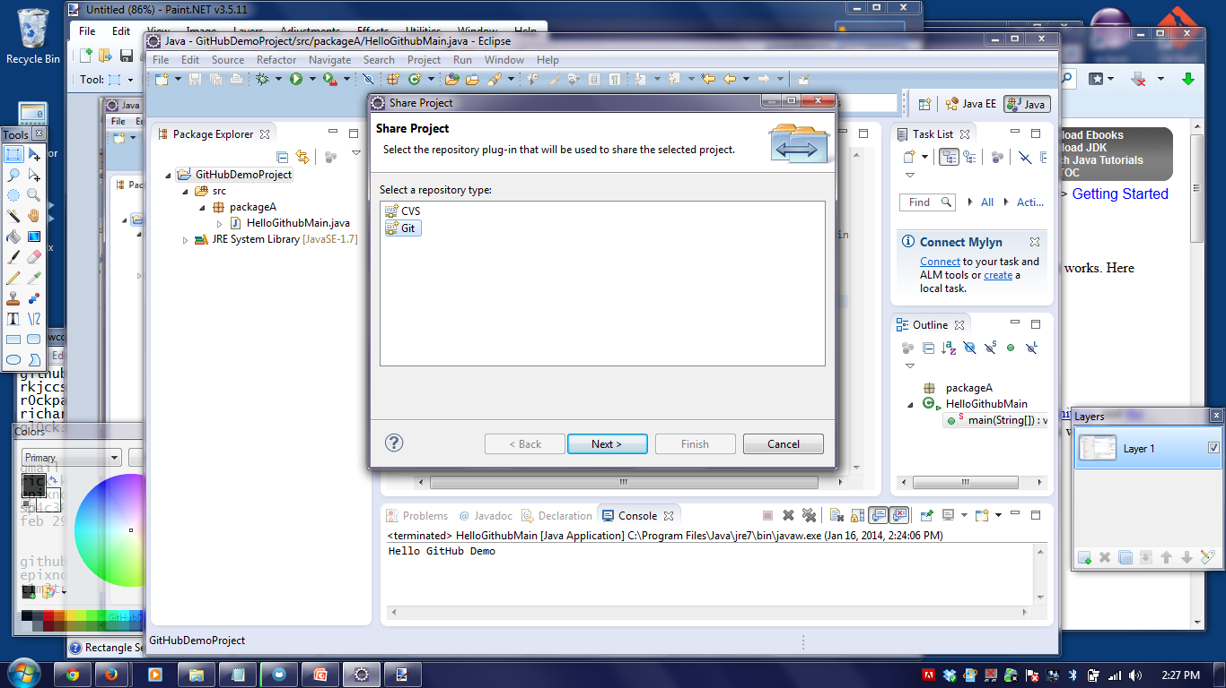
Share (team->share) the project to create a local repository

Slide 16
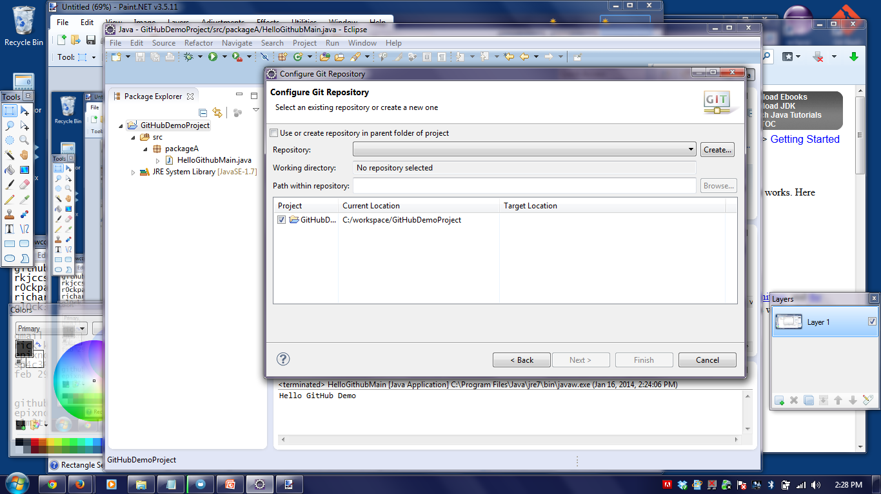
Local repository

Slide 17
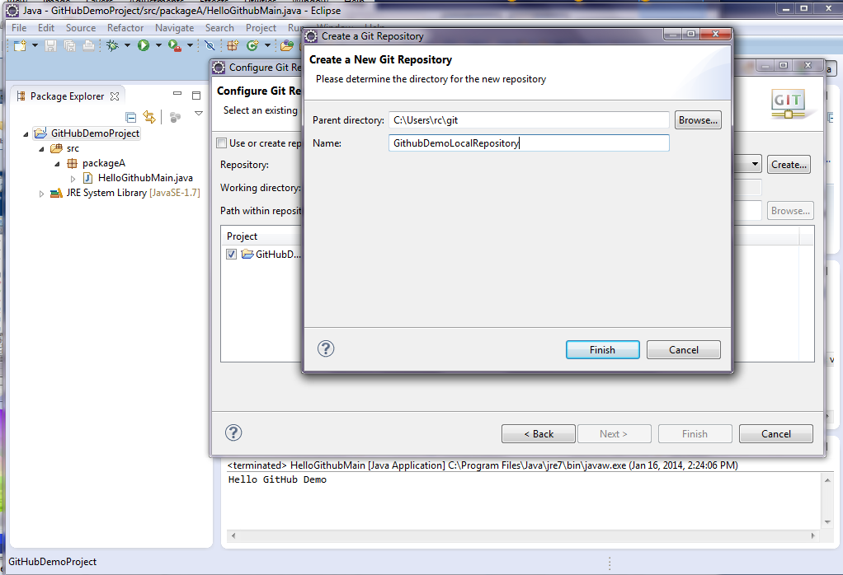
More local repository

Slide 18
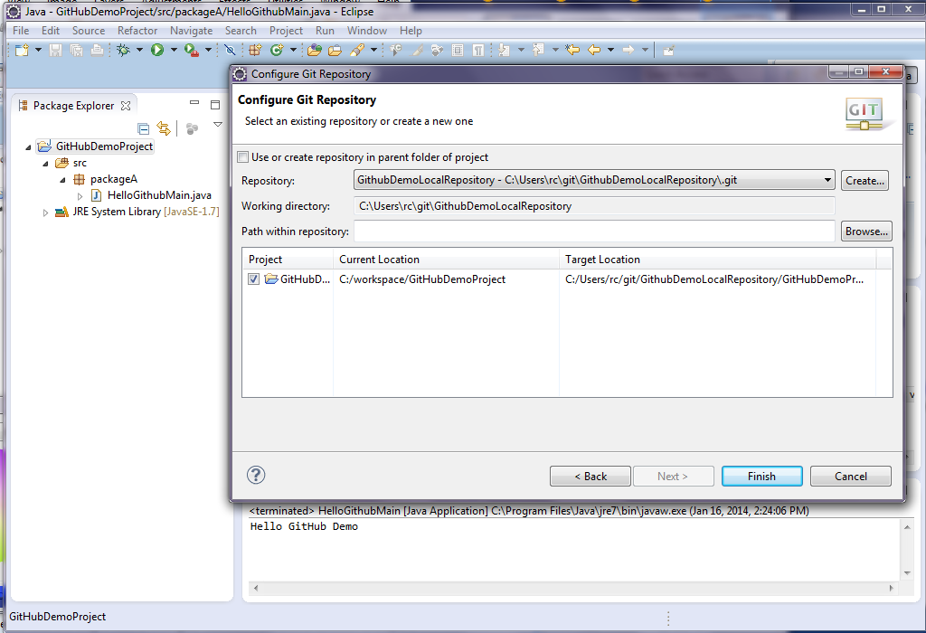
…and finish local repository

Slide 19
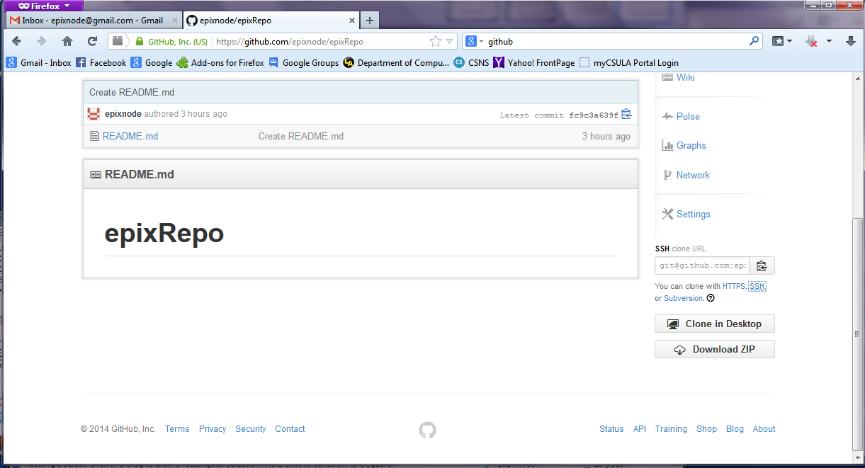

Slide 20
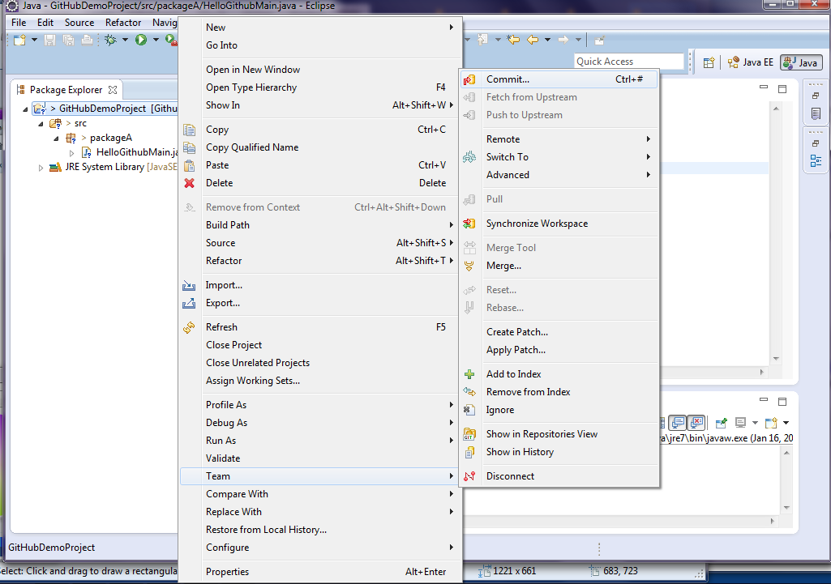
Don’t forget to commit after creating the repository

Slide 21
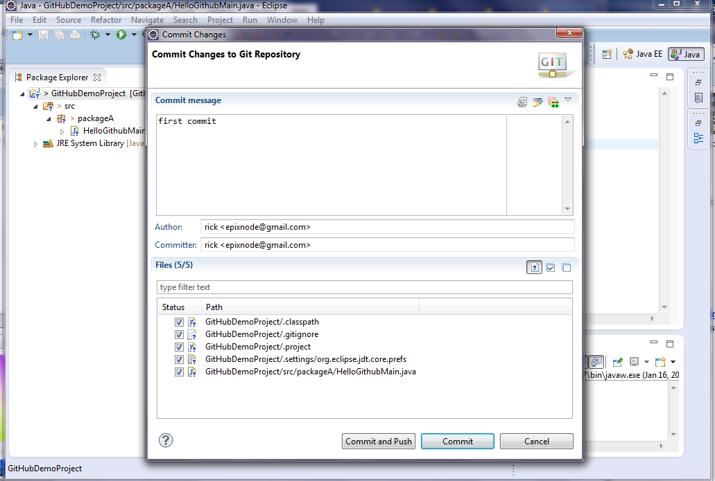
commit

Slide 22
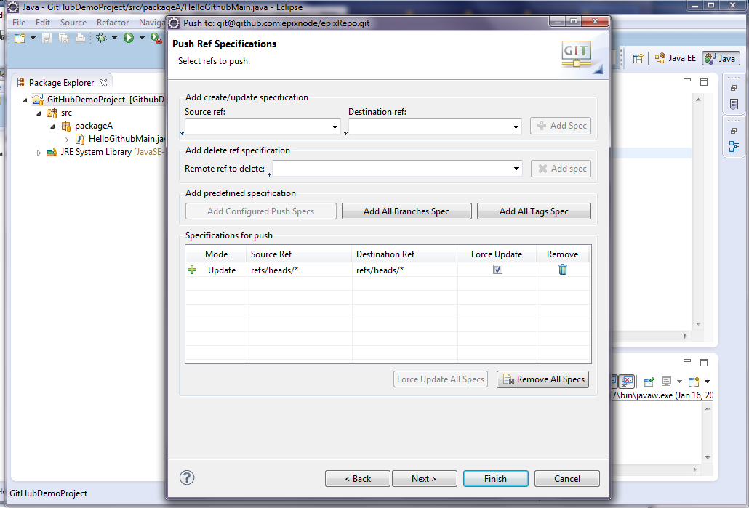
Pushing the local project repository to the GitHub repository you created earlier.

Slide 23
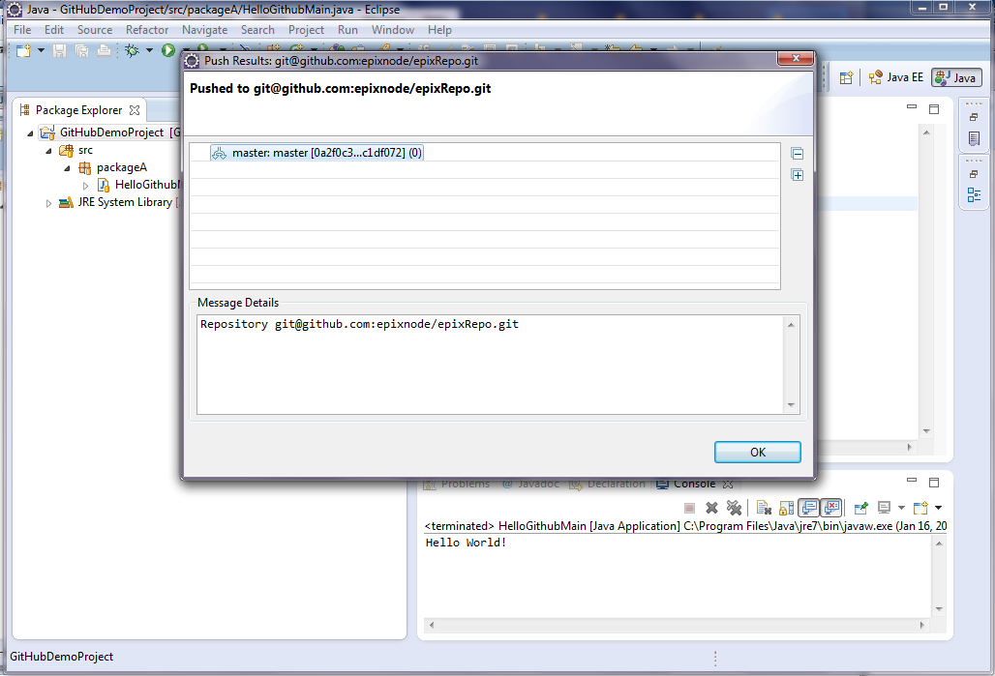
and ok

Slide 24
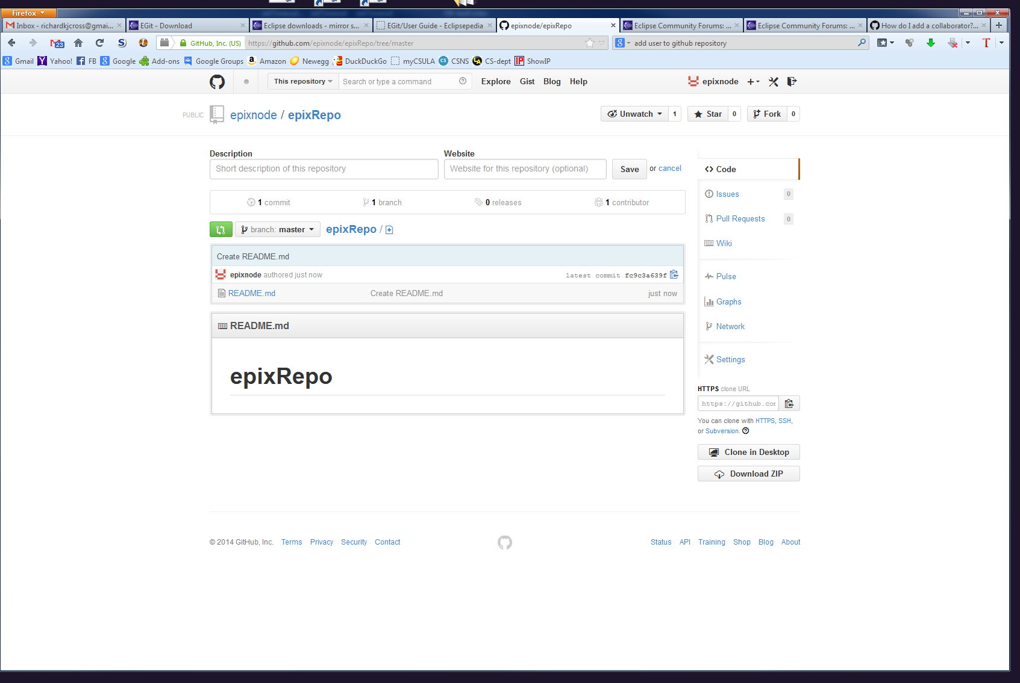
Before the push.
This was what we created when we set up the repository.

Slide 25
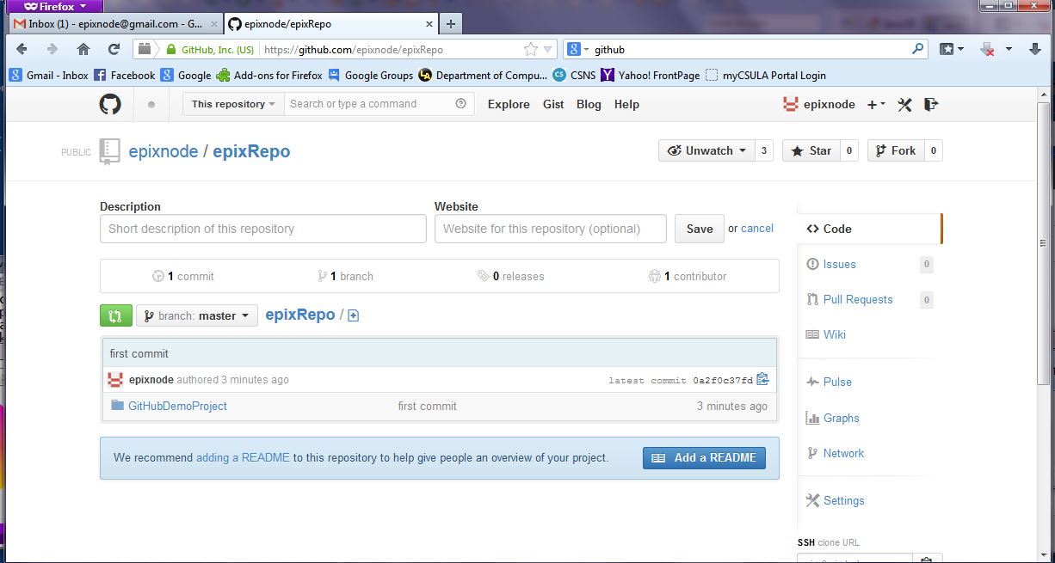
After the push. The existing readme file was wiped out because the whole repository is now a duplication of what was in Eclipse – something to keep in mind.

Slide 26
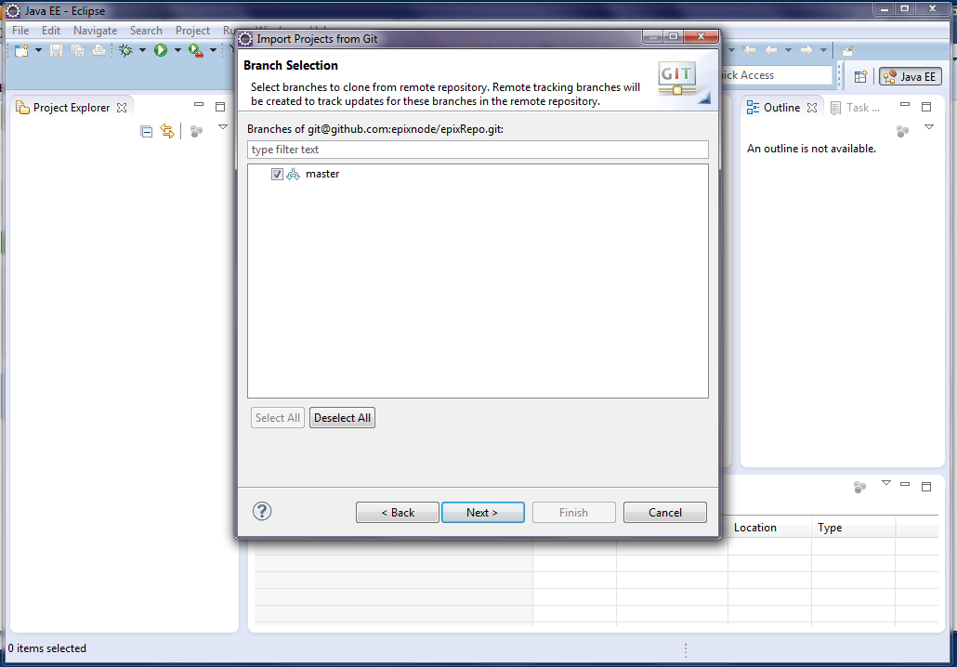
The rest of the team now needs to clone the project onto their machines

Slide 27
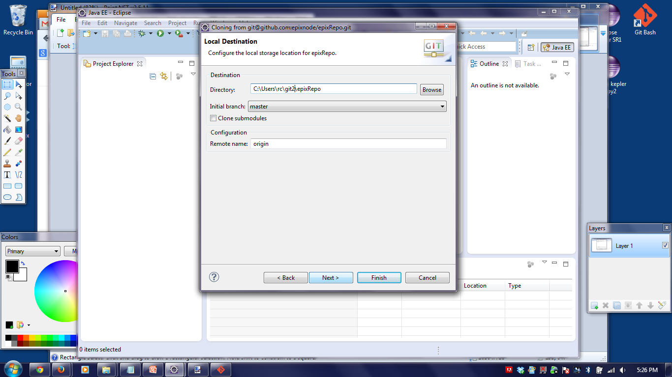
cloning

Slide 28
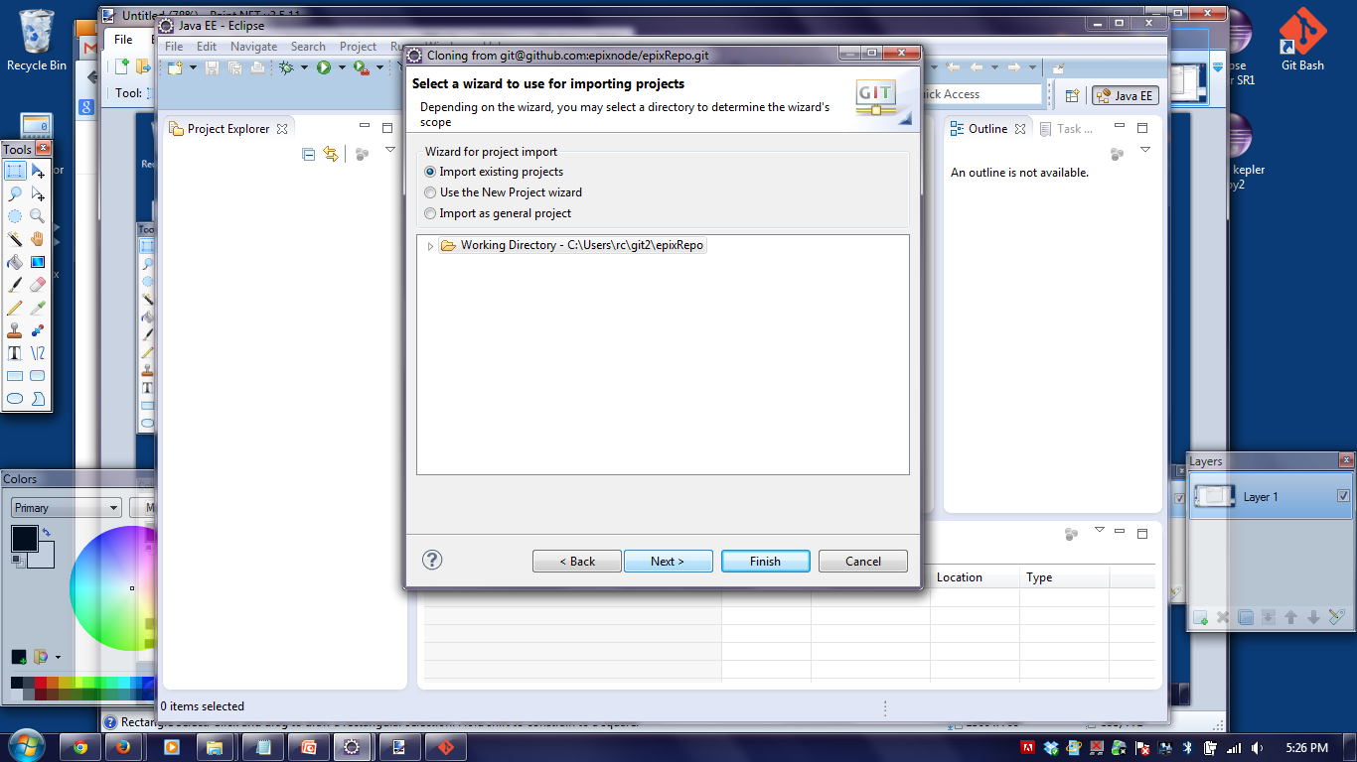
More cloning

Slide 29
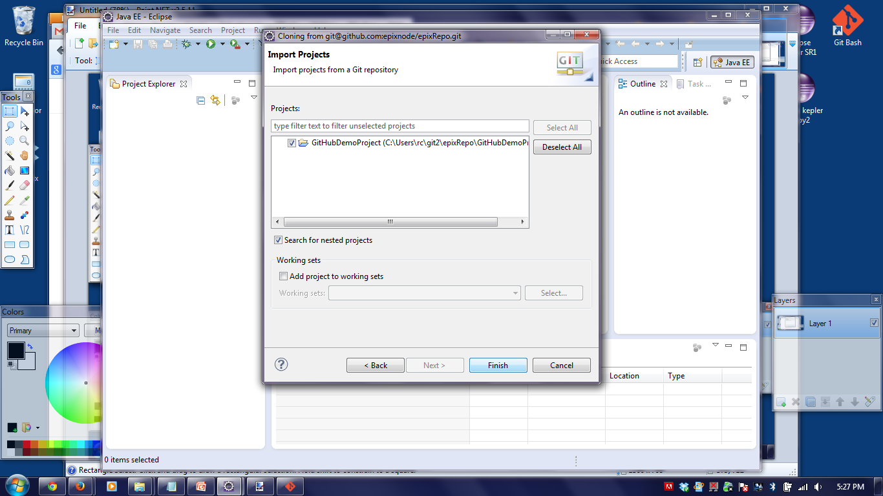
Finished cloning

Slide 30
For enhanced control install Git Bash. Combination of Git and a Bash shell that runs on Windows
After creating the repository with Eclipse navigate to it and connect the commandline Git to the GitHub repository:
git remote add origin <remote_repo_url>

Slide 31
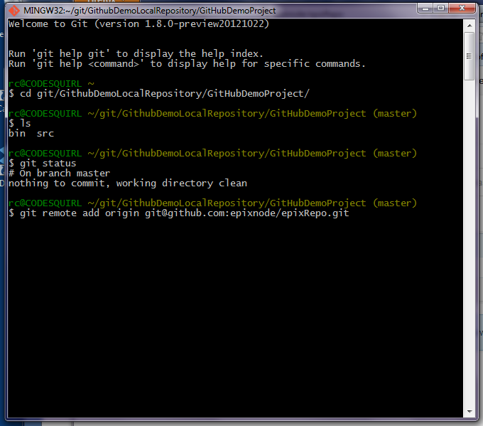
Git Bash remember – it uses linux commands and path syntax

Slide 32
Using Git
Branch
Add
Commit
Push
Merge

